Slide 1
Communicable Diseases

Slide 2
Overview
What are the determinants of selected communicable diseases?
What are the key concepts concerning prevention, transmission, and treatment?
What are the costs and consequences of communicable diseases?
What are examples of successful interventions?
What are the key challenges to future efforts?

Slide 3
The Importance of Communicable Diseases
Cause 31% of deaths and 40% of DALYs in low- and middle-income countries
Disproportionately affect the poor
Enormous economic consequences
Relevance to Sustainable Development Goals
Much of the burden of communicable diseases is avoidable, many can be prevented or treated

Slide 4
Key Terms, Definitions, Concepts
Communicable disease - transmission:
  animal-animal
  animal-human
  human-human
Synonymous with infectious or contagious disease
Microbes/microorganisms that cause disease are called pathogens
What are some examples of pathogens?

Slide 5
Examples of Types of Microorganisms
Viruses
Bacteria
Fungi
Protozoa
Parasites

Slide 6
Key Terms
Transmission paths for communicable diseases: examples
Foodborne: Salmonella, E. coli, Hepatitis A & E
Waterborne: Cholera, Rotavirus
Sexual or bloodborne: Hepatitis B & C, HIV
Sexual contact only: Gonorrhea, Chlamydia, HSV other STIs
Vector-borne: Malaria, onchocerciasis
Air-borne/Inhalation: Tuberculosis, influenza, meningitis
Non-traumatic contact: Anthrax
Traumatic contact: Rabies

Slide 7
Key Terms, Concepts
Case: an individual with a particular disease
Case fatality rate: the proportion of persons with a particular condition (cases) who die from that condition
Control (disease control): reducing the incidence and prevalence of a disease to an acceptable level
Elimination (of disease): reducing the incidence of a disease in a specific area to zero

Slide 8
Key Terms
Emerging infectious disease: a newly discovered disease
Eradication (of disease): termination of all cases of a disease and its transmission globally
Parasite: an organism that lives in or on another organism and takes its nourishment from that organism
Reemerging infectious disease: an existing disease that has increased in incidence, spread to new place, or has taken on new forms

Slide 9
Key Terms
Different control measures:
Vaccination
Mass chemotherapy
Vector control
Improved water, sanitation, hygiene
Improved care seeking, disease recognition
Case management (treatment) and improved caregiving
Case surveillance, reporting, and containment
Behavioral change

Slide 10
The Costs and Consequences of Communicable Diseases
Constrain health and development of children, affecting schooling and adult productivity
Strong stigma and discrimination associated with HIV, TB, and others such as leprosy
Limit productivity and income of adult workers
Costs of treatment burden families
High rates of communicable diseases reduce investment in a country’s development

Slide 11
The Burden of Emerging and Reemerging Infectious Diseases
Examples of emerging infectious diseases:
  SARS (Severe Acute Respiratory Syndrome), China (2002)
  MERS (Middle East Respiratory Syndrome), Arabian Peninsula (2012)
Examples of reemerging infectious diseases:
  Cholera, Peru (1997)
  Ebola, West Africa (2014)

Slide 12
The Burden of Emerging and Reemerging Infectious Diseases
Truly global threats and “a perpetual challenge”
Zoonoses (infection spread from animals to humans) cause of about 60%
Key factors include microbial adaptation and change, climate, changing ecosystems, international travel and commerce, and war
578 outbreaks in 132 countries from 1998–2001

Slide 13
Antimicrobial Resistance
Resistant forms of disease can emerge or reemerge when bacteria, parasites, and viruses are altered through mutation, natural selection, or the exchange of genetic material among strains and species
Examples of drug resistance:
  HIV, any first-line drug
  MRSA, beta-lactams

Slide 14
Antimicrobial Resistance
In 2013, about 480,000 people globally developed multidrug-resistant TB
There is resistance to all malaria drugs
Factors contributing to development of drug resistance include increasing use of drugs, poor prescribing and dispensing practices, inappropriate use, failure of patients to take correct dosages, and counterfeit drugs

Slide 15
The Leading Burdens of Communicable Diseases
The Consequences of Emerging and Reemerging Infectious Diseases
Selected examples of the Economic Costs of Emerging and Reemerging Infectious Diseases
Disease | Country | Years | Cost
Cholera epidemic | PERU | 1991 | $771 million
Plague | INDIA | 1994 | $1.7 billion
Mad Cow Disease | UNITED KINGDOM | 1990-1998 | $30 billion
Anthrax | UNITED STATES | 2001 | $1 billion
SARS | ASIA | 2003 | $30 billion

Slide 16
The Consequences of Emerging and Reemerging Infectious Diseases
Substantial direct and indirect costs, that are not proportional to deaths from these events
Drug resistance costs are also very high
Treating a case of drug-resistant TB has been estimated to be about 175 times the cost of treating a case with first-line drugs

Slide 17
Addressing Emerging and Reemerging Infectious Diseases
Sensitive surveillance systems and public health laboratories
Global collaboration and willingness to share information with other countries
Rapid detection of new outbreaks
Mechanisms for effective containment

Slide 18
Addressing Emerging and Reemerging Infectious Diseases
Global Outbreak Alert and Response Network (GOARN)
a network of existing disease surveillance networks established in 2000

Slide 19
Addressing Antimicrobial Resistance
Improved surveillance and laboratory capacity
Uninterrupted access to essential medicines of assured quality
The regulation of medicines, including in animal husbandry
Improved infection control
Innovation

Slide 20
Healthcare-Associated Infection
A healthcare-associated infection (HAI) = a nosocomial infection = a hospital-acquired infection = an infection that is contracted while receiving care in a hospital, nursing or rehabilitation center, or other medical facility.
Some HAIs are drug resistant, such as MRSA (methicillin-resistant Staphylococcus aureus).
Antimicrobial stewardship programs that ensure that patients are prescribed the right drug at the right dose for the right duration and through the right route serve to limit the risk of adverse outcomes of HAIs, including drug-resistant infections.
A new “superbug” that evolves anywhere in the world poses a threat to the whole world.

Slide 21
Future Challenges
Impact of economic crisis on governments’ ability to fund public health functions
Rapidly evolving pathogens, population growth, climate change will increase number of emerging diseases
Possibility of a major pandemic
Accelerating drug resistance
Limited number of anti-infective drugs being developed

Slide 22
The Burden of HIV/AIDS (2016)
Number of people living with HIV/AIDS: 36.7 million
2.1 million under 15 years old
Prevalence among adults aged 15–49: 0.8%
Number of new HIV infections: 1.5 million (including 160,000 under 15yrs)
Number of HIV-related deaths: 1.0 million
Proportion of all adults living with HIV receiving ART: 38%
Percentage of pregnant women receiving ART increased to 76% in 2016 from 47% in 2010
https://www.hiv.gov/hiv-basics/overview/data-and-trends/global-statistics
http://www.who.int/gho/hiv/epidemic_status/prevalence_text/en/

Slide 23
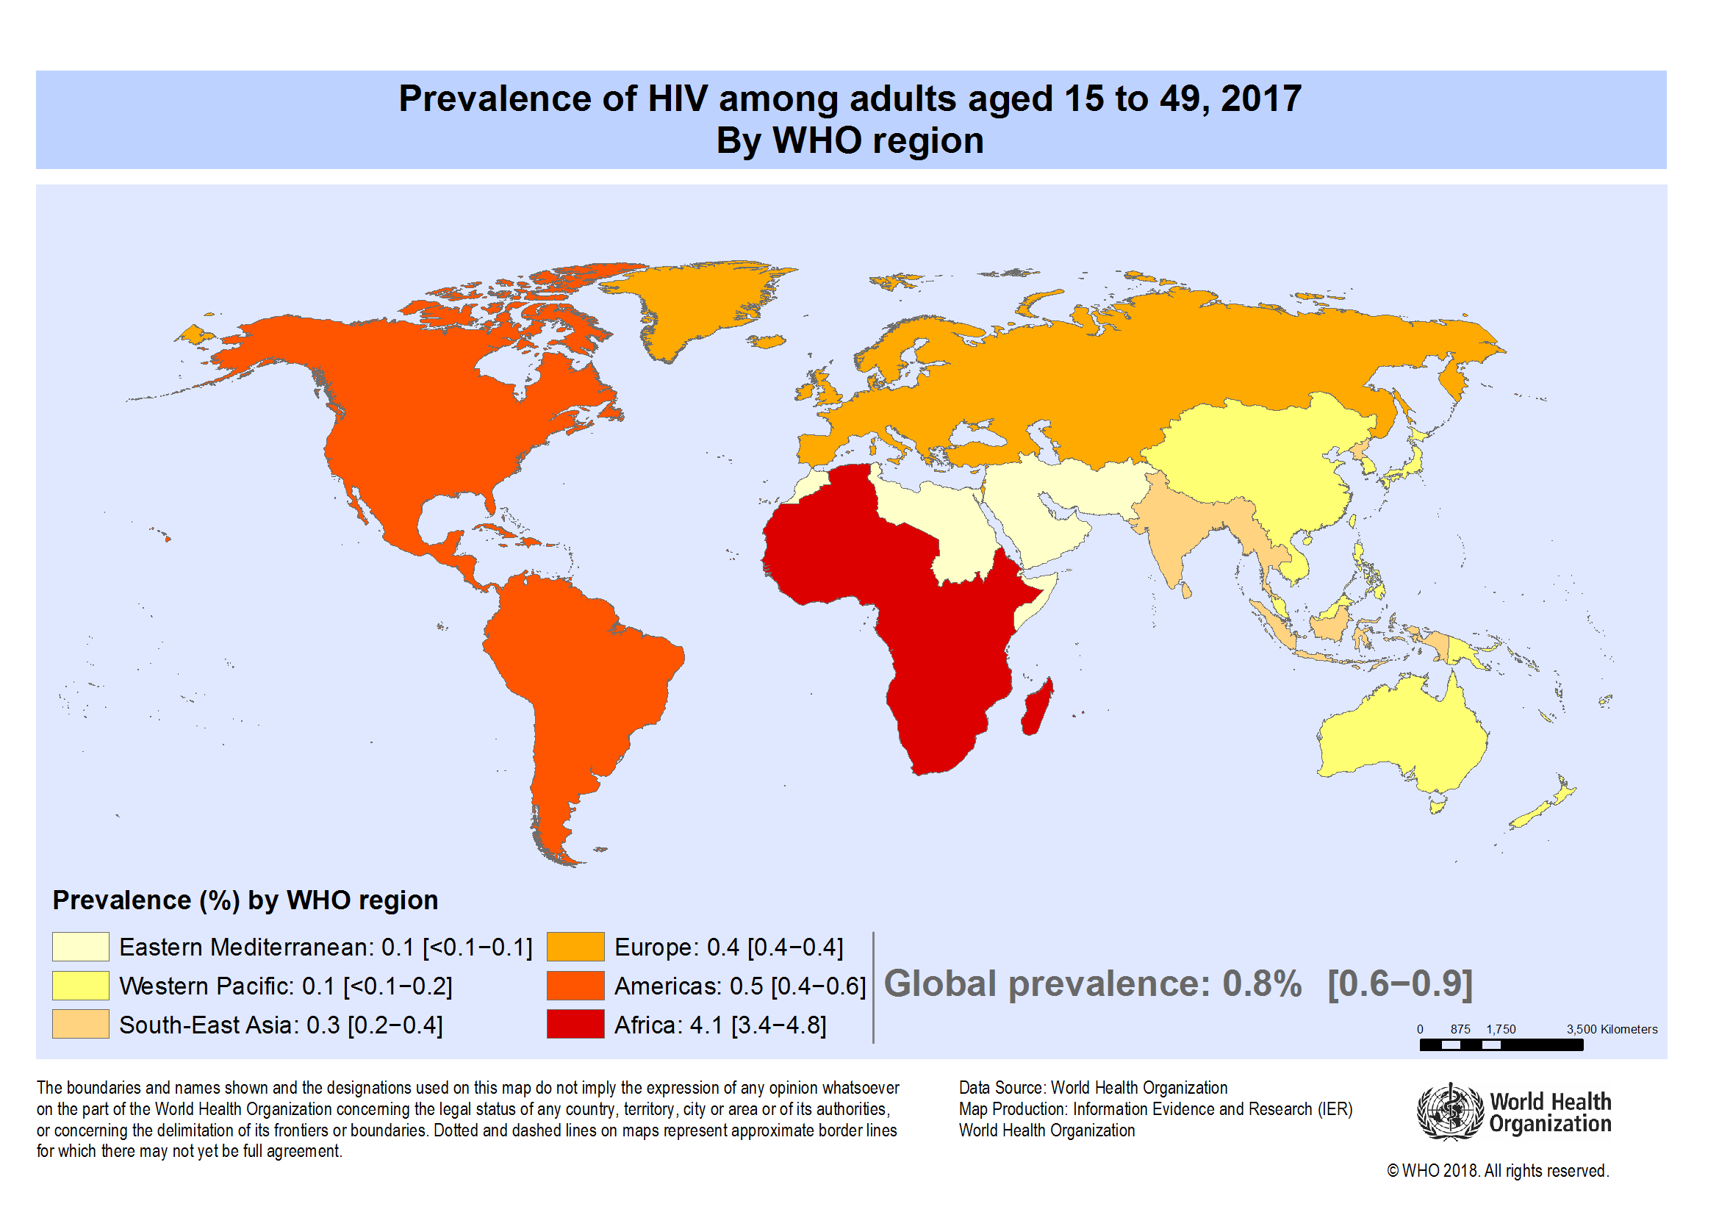
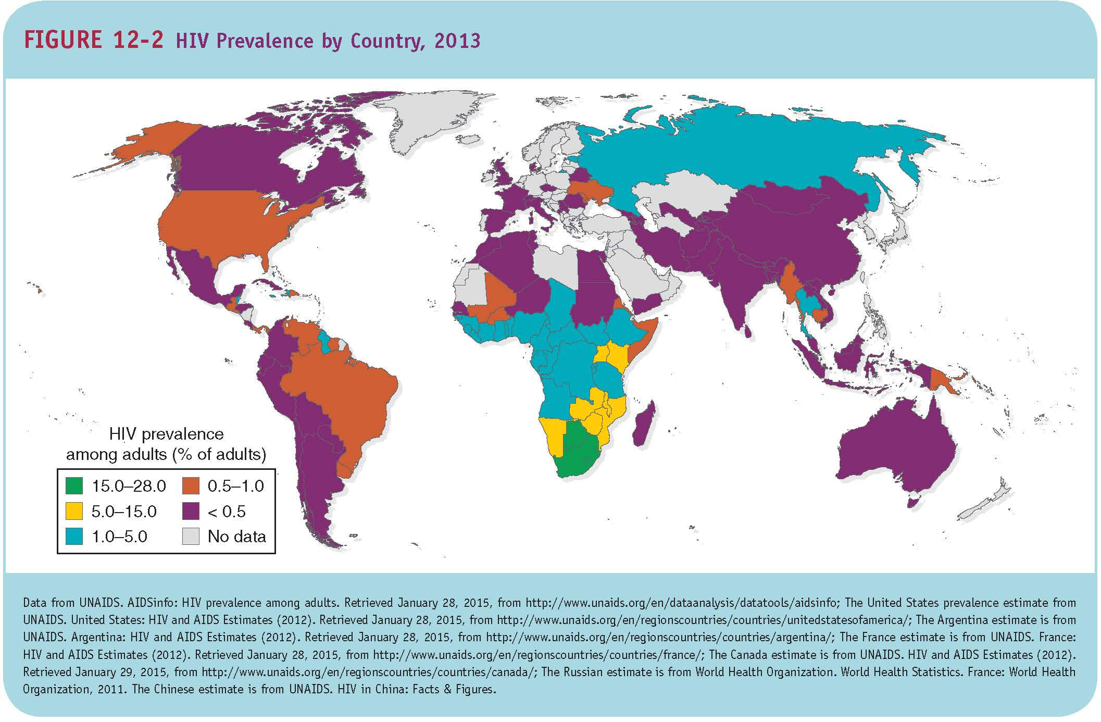
The Burden of HIV/AIDS

Slide 24
HIV/AIDS
When HIV first appeared in a population, it was generally concentrated in sex workers, men who have sex with men, or injection drug users
Highest prevalence rate of HIV/AIDS is sub-Saharan Africa: 4.7% of the adults aged 15–49
New HIV infections predominantly in people aged 15–24, or infants from mother-to-child transmission

Slide 25
HIV Treatment
The global community has made a commitment to trying to ensure that all people with HIV are placed on treatment when clinically eligible
Clinically eligible: CD4 cell count below 500
As of June 2017, about 20.9 million people were on treatment
About 34% of the eligible adults in low- and middle-income countries are being treated

Slide 26
The Costs and Consequences of HIV/AIDS
Enormous impacts in high prevalence countries that go beyond morbidity & mortality
A person with full-blown, untreated AIDS cannot work and will become dependent on others for care
Creates exceptional number of orphans
Highly stigmatized condition
Direct cost of treatment high for the poorest countries

Slide 27
Addressing the Burden of HIV/AIDS
Need for a vaccine
Focus on prevention of new infections and 90-90-90
Successful efforts have included strong political leadership and open communication
Approach to prevention must vary with nature of epidemic
Efforts need to combine education and behavioral change, bio-medical approaches, structural approaches, and early treatment

Slide 28
Addressing the Burden of HIV/AIDS
Successful efforts will involve:
Condom promotion
Screening and treatment for STIs
Prevention of mother-to-child transmission
Voluntary male medical circumcision
Interventions that target populations that transmit the virus from high-risk to low-risk populations

Slide 29
Addressing the Burden of HIV/AIDS
90-90-90 goals by 2020:
90% of the people with HIV will know their HIV status
90% of those with HIV will be receiving antiretroviral therapy
90% of those being treated will have suppressed viral loads

Slide 30
Critical Challenges in HIV/AIDS
Developing a vaccine
Cost-effective approaches to prevention in different settings
Universal treatment for all those who are eligible
Financing treatment
Management of TB and HIV co-infection

Slide 31
The Burden of TB (2017)
Number of people living with TB: 11 million
Number of new TB cases: 10 million
Number of TB deaths: 1.6 million
TB leading killer of persons with HIV
Proportion of new cases with multidrug-resistant TB: 3.5%
54 million lives saved by TB diagnosis & treatment between 2000 and 2017
http://www.who.int/news-room/fact-sheets/detail/tuberculosis

Slide 32
Tuberculosis
An untreated person with active pulmonary TB can infect 10 to 15 people annually
About two-thirds of those with active TB disease will die of the disease if not treated properly
TB remains latent in the bodies of about 90% of those infected and they are not sick now but can develop TB later

Slide 33
The Costs and Consequences of TB
TB patients lose about 60% of their individual annual income and 40% of household income due to falling ill with TB
Could be financially catastrophic to many families
Stigmatized condition
Economic growth of a country inversely correlated with the rate of TB

Slide 34
Addressing the Burden of TB
Bacillus Calmette–Guérin (BCG) vaccine has limited impact on incidence or prevalence
Control of TB depends on effective treatment of active tuberculosis and social determinants
WHO recommends a 6-month regimen for drug-susceptible disease; includes four drugs; highly cost-effective: $5–$50 per DALY averted
Patient adherence with TB regimen is essential

Slide 35
Management of TB/HIV Co-infection
TB is an opportunistic infection of HIV
“Scaling up the three Is”
  Intensified case finding
  Giving isoniazid (antibiotic) to people with HIV to help prevent their getting TB
  Enhancing infection control in healthcare settings so that TB does not spread

Slide 36
Challenges in TB Control
The WHO End TB Strategy seeks to end the global epidemic by 2035, with a 95% reduction in deaths and reduce incidence to 10 per 100,000 people
Focuses on expanding TB prevention and care
Putting the new strategy in place requires additional financial and technical resources

Slide 37
Challenges in TB Control
Need for more effective vaccines, inexpensive and rapid diagnostics, and drug therapy that will lessen duration of treatment
Improving identification and treatment of MDR-TB and XDR-TB
Further efforts at linking all providers of TB diagnosis and treatment with national TB control programs

Slide 38
Multi-drug Resistant TB
“Anti-TB medicines have been used for decades and strains that are resistant to 1 or more of the medicines have been documented in every country surveyed. Drug resistance emerges when anti-TB medicines are used inappropriately, through incorrect prescription by health care providers, poor quality drugs, and patients stopping treatment prematurely.”
http://www.who.int/news-room/fact-sheets/detail/tuberculosis

Slide 39
Multidrug-Resistant TB
Drug-resistant TB (DR-TB) is a growing global health problem.
  The default rate, the proportion of people who are diagnosed but do not complete the full course of treatment, is high in some places.
Multidrug-resistant TB (MDR-TB) is a TB strain that does not respond to two of the standard antibiotic therapies, rifampicin and isoniazid.
  In 2015, about 3.9% of new cases of TB and 21% of previously treated cases were MDR-TB or rifampicin-resistant TB (RR-TB), but in some countries and regions the proportion is much higher.
Extensively drug-resistant TB (XDR-TB) is resistant to rifampicin, isoniazid, fluoroquinolones, and at least one second-line injectable TB drug.

Slide 40
MALARIA

Slide 41
Plasmodium
Malaria = a parasitic infection with protozoa from the Plasmodium species.
There are five types of Plasmodium known to cause human infection.
Falciparum malaria is generally the most serious infection.
  Nearly 90% of all malaria cases and deaths occur in sub-Saharan Africa, and nearly 99% of these cases are caused by P. falciparum.
  Outside of sub-Saharan Africa, about half of cases are caused by P. falciparum and half by P. vivax.
The parasites that cause malaria have a very complex lifecycle that involves developmental stages in both humans and mosquitoes.

Slide 42
Symptoms
Malaria usually presents with cyclic fevers, headaches, joint pain, and other symptoms of influenza-like illnesses, but it can cause organ failure and death.
Malaria can cause weeks or even months of illness due to relapses and fatigue.
  Reinfection is common, and in many tropical areas the average child has several bouts of malaria each year.
Children and pregnant women are most at risk for severe complications and death.
  Malarial anemia = the destruction of so many red blood cells that the body cannot adequately transport oxygen through the bloodstream.
  Cerebral malaria = malaria that causes seizures and coma (impaired consciousness).
  Babies born to mothers with malaria are at increased risk of low birthweight and other birth complications.

Slide 43
Malaria Interventions
The only way that humans contract malaria is by being bit by an infected mosquito, and the only way that mosquitoes become infected is by biting an infected human.
There are two key types of malaria control interventions:
  Reduce the likelihood of a human being bit by a mosquito.
  Treat people with malaria so that they regain health and so that mosquitoes that bite them will not contract malaria.

Slide 44
Malaria Treatment
Strains of malaria are becoming resistant to many of the drugs that used to be effective against it.
Treating infections with combinations of drugs slows the emergence of drug resistance.
  Malaria control experts strongly urge the use of artemisinin-based combination therapy (ACT) that combines at least two different antimalarial drugs (such as artemether plus lumefantrine or artesunate plus mefloquine), one of which is an artemisinin-based drug.
Treating only laboratory-confirmed cases (with a few exceptions) also prevents drug resistance from emerging.
  A rapid diagnostic test (RDT) can detect the presence of a pathogen or markers for a pathogen within 15 to 30 minutes.

Slide 45
Intermittent Preventive Treatment
Intermittent preventive treatment (IPT) = the use of “preventive chemotherapy” with anti-malarial medications in vulnerable people so that they maintain therapeutic drug levels in their blood during times of high risk for malaria.
IPT in pregnancy (IPTp) = the routine distribution of anti-malarial medications to all pregnant women who live in malaria-endemic countries, even if the women do not have symptoms of malaria at the time of treatment.
  Presumptive treatment for malaria with IPTp is effective at increasing the average birth weight and survival rates of babies born to women who receive the recommended doses.

Slide 46
Insecticide-Treated Net
Barriers between humans and mosquitoes prevent mosquito bites and interrupt the mosquito–human–mosquito transmission cycle.
Insecticide-treated net (ITN) = a mesh sheet dipped in insecticides and then hung over a bed to provide a barrier between sleeping humans and mosquitoes while also killing any mosquitoes that land on it.
  Most ITNs need to be re-dipped in pyrethroid insecticides every 6 months or so to maintain effectiveness.
  Long-lasting insecticidal net (LLIN) = an ITN that has been impregnated with a pesticide that remains effective for 2 years or longer before requiring retreatment.

Slide 47
Insecticide-Treated Net (cont’d)
ITNs significantly reduce child mortality in malaria-endemic areas when they are used consistently.
  The proportion of young children in sub-Saharan Africa who sleep under an ITN increased significantly since 2000.
  About two-thirds of the reduction in malaria cases between 2000 and 2015 are attributed to scaled-up use of ITNs.
  It is also important for malaria patients to stay under a bednet so mosquitoes cannot bite them and become carriers of malaria.

Slide 48
The Burden of Malaria (2013)
Number of people at risk of infection: 3.2 billion
Number of malaria cases: 198 million
Number of malaria-related deaths: 548,000
Burden of malaria-related deaths: 90% in Africa; 78% occurred in children under 5 years of age
Proportion of households owning at least one insecticide-treated bednet: 67%

Slide 49
The Burden of Malaria
In 2014, 97 countries had ongoing transmission
Leading cause of DALYs in sub-Saharan Africa among all age groups
The most important risk factor for malaria is being bitten by mosquitoes that carry the malaria parasite
Pregnant women who contract malaria are at high risk of giving birth to low birthweight children

Slide 50
Costs and Consequences of Malaria
Individuals often have malaria up to 5 times per year
Indirect costs are greater than direct costs of treatment due to lost days of work
Roll Back Malaria suggests that economic costs in countries with a high burden are equal to 1.3% of GDP per year

Slide 51
Key interventions:
Malaria
Prompt treatment of those infected, based on confirmed diagnosis
Intermittent preventive therapy for pregnant women
Long-lasting insecticide-treated bednets for people living in malarial zones
Indoor residual spraying in malarial zones
Notes:
Stopped here

Slide 52
Addressing the Burden of Malaria
Appropriate treatment required so that when mosquitos bite people they will not carry malaria to another person
WHO today recommends artemisinin-based combination therapies (ACT) for treating uncomplicated malaria caused by P. falciparum and for treating P. vivax infections that are not responsive to chloroquine
Notes:
Stopped here

Slide 53
Challenges in Addressing Malaria
The previous global goals for malaria include:
Reducing global malaria cases from 2000 levels by 75% in 2015
Reducing global malaria deaths to zero by 2015
Eliminating malaria in 8 to 10 countries by 2015
Eliminating malaria in the European region by 2015

Slide 54
Action and Investment to Defeat Malaria 2016-2030
Goals | Milestones |  | Targets
 | 2020 | 2025 | 2030
Reduce malaria mortality rates globally compared with 2015 | At least 40% | At least 75% | At least 90%
Reduce malaria case incidence globally compared with 2015 | At least 40% | At least 75% | At least 90%
Eliminate malaria from countries in which malaria was transmitted in 2015 | At least 10 countries | At least 20 countries | At least 35 countries
Prevent re-establishment of malaria in all countries that are malaria free | Re-establishment prevented | Re-establishment prevented | Re-establishment prevented
Notes:
http://www.rollbackmalaria.org/about/about-rbm/aim-2016-2030
http://apps.who.int/iris/bitstream/10665/176712/1/9789241564991_eng.pdf?ua=1&ua=1

Slide 55
Challenges in Addressing Malaria
Substantial gaps in diagnosis and treatment
National malaria programs must find effective ways of working with private medical providers
Better diagnostics and development of new drugs
Growing resistance to the insecticides used for indoor residual spraying
A safe, effective, and affordable vaccine

Slide 56
The Burden of Diarrheal Disease
Mortality has decreased significantly in the past 30 years, from an estimated 4.6 million deaths in the 1980s to 760,000 deaths in 2013
Most significantly impacts the poor
Fourth leading cause of death for under-5 children in low- and middle-income countries
Third leading cause of DALYs among under-5 children

Slide 57
Diarrheal Disease
Disease prevention strategies:
Promotion of exclusive breastfeeding for the first six months
Improved complementary feeding, after six months
Rotavirus and measles immunization
Improving access to clean water supply and sanitation

Slide 58
Addressing the Burden of Diarrhea
Case management interventions include oral rehydration therapy, zinc supplementation, and selective antibiotics (as appropriate)
ORT is the most cost-effective but only about 49% of cases are managed with ORT or home fluids
Zinc supplementation for 10 to 14 days during and after diarrhea could prevent 300,000 deaths per year

Slide 59
Vaccination
Vaccination = the intentional delivery of a substance into the body in order to stimulate development of immunity against a particular disease.
Immunization = the process of a person’s immune system developing immunity against a particular infection.
  Vaccination is the action of delivering a vaccine to an individual; immunization is what happens in the body after a vaccine is injected or otherwise dispensed.
Antibody = a protein produced by the human body in response to the presence of antigens; antibodies can bind to antigens and destroy them.

Slide 60
Immunity
Active immunity is present when the body’s immune system produces antibodies against a specific infectious agent.
  Conferred by both infection and vaccination
  Confers long-lasting protection against an infectious disease
Passive immunity is temporary protection from antibodies produced by another human or an animal.
  Newborns and infants have some protection from maternal antibodies.
  Blood products and immunoglobulin shots also provide passive immunity.

Slide 61
Types of Vaccines
A live attenuated vaccine contains a pathogen that has been weakened with various laboratory techniques.
An inactivated vaccine contains a killed bacterium or an inactive virus that has been rendered harmless by heat, chemical, or radiation.
An adjuvant is an ingredient added to some types of vaccines to boost the body’s immune response to the vaccine.
A fractional vaccine contains parts of a pathogen rather than the entire microbe.

Slide 62
Vaccine Safety
Licensed vaccines have undergone extensive testing to prove they are safe for most people.
Adverse reaction = a side effect of vaccination (most often redness at the injection site or local pain).
Adverse event = adverse reaction or other medical event that occurs after vaccination but appears to be coincidental rather than being a result of the vaccine.

Slide 63
Vaccine Safety (cont’d)
Contraindication = a condition that makes it unsafe for an individual to receive a particular vaccine.
Precaution = a condition that might make a vaccine ineffective at producing immunity or might increase the likelihood of an adverse reaction in a particular individual.

Slide 64
Vaccine-Preventable Infections
9.8

Slide 65
Routine Vaccinations
The first global vaccination initiative was the Expanded Program on Immunization (EPI), which was established by the World Health Organization in 1974 to ensure universal child access to vaccines for six vaccine-preventable diseases (VPDs): measles, polio, tuberculosis (BCG), diphtheria, tetanus, and pertussis.
About a dozen vaccines are now routinely recommended for children, including mumps, rubella, hepatitis B, influenza, Hib, pneumococcus, and rotavirus.

Slide 66
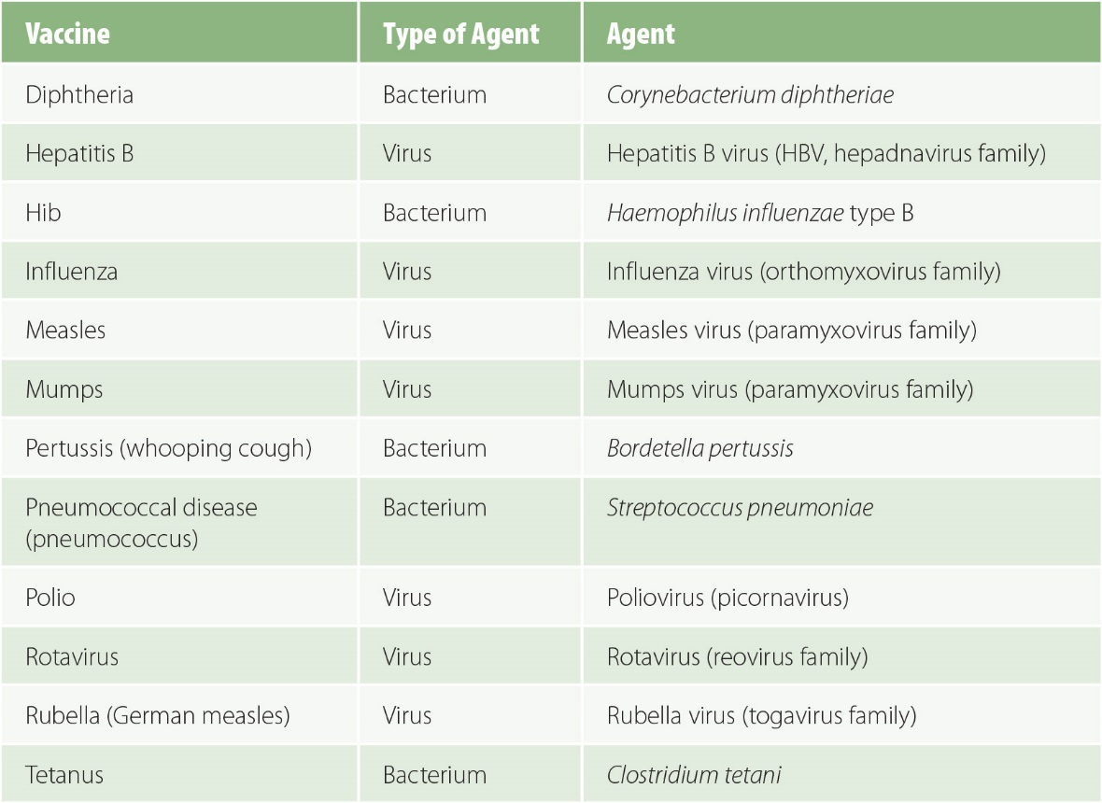
Figure 9-14
Routinely recommended childhood vaccinations.

Slide 67
Measles, Mumps, Rubella (MMR)
Measles = a very contagious viral infection that can cause serious complications, especially in children who are vitamin A deficient.
  The number of measles deaths worldwide per year decreased from an estimated 650,000 in 2000 to 135,000 in 2015, an 80% decrease in just 15 years.
  The percentage of infants receiving at least one dose of a measles-containing vaccine (MCV) increased from 72% to 85% during those 15 years.
Mumps causes swollen cheeks and may lead to male infertility.
Rubella can cause congenital defects if pregnant women contract it.

Slide 68
Herd Immunity
The theory of herd immunity says that reducing the proportion of a population that is susceptible to an infection protects the whole population, including those who are unable to receive vaccines.

Slide 69
Viral Hepatitis
Several types of viral hepatitis caused by very different types of viruses can trigger inflammation of the liver.
About 1 million people each year die from acute or chronic viral hepatitis or the aftereffects of chronic infection, including HBV- and HCV-associated liver cancers.

Slide 70
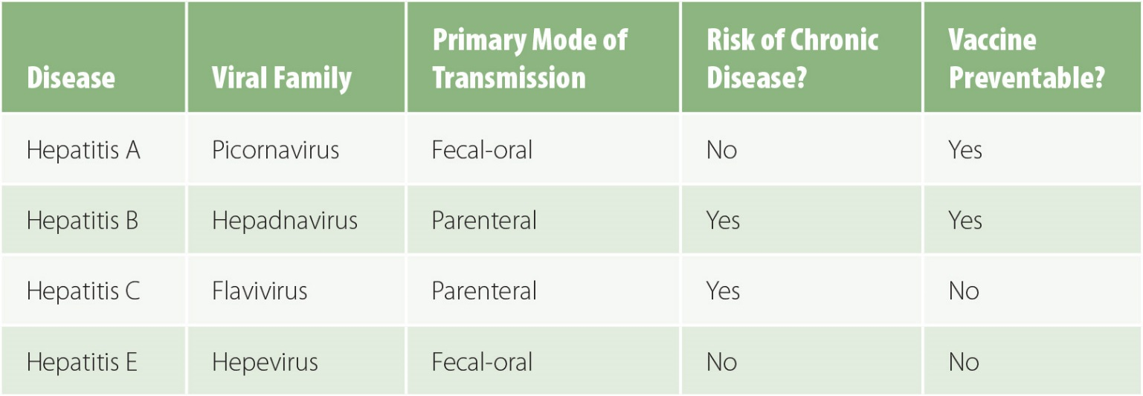
Figure 9-20
Major types of viral hepatitis

Slide 71
Meningitis
Meningitis = inflammation of the meninges, the membranes the cover the brain and spinal cord.
  Viral infections are the most common cause of meningitis, but bacterial meningitis is of greater concern because it has a higher case fatality rate.
  Three of the frequent causes are vaccine-preventable: pneumococcus, meningococcus, and Hib.
Meningococcus = the disease caused by infection with the bacterium Neisseria meningitidis.
  The “meningitis belt” extends across the northern countries of sub-Saharan Africa where large outbreaks of meningococcus have historically occurred every few years during the dry season.

Slide 72
Neglected Tropical Diseases
There are 13 parasitic and bacterial infections
Worldwide: more than 1 billion infected (about 1 in 6); about 500 million children
Diseases of poverty
Terrible impact on health, impede child growth and development, harm pregnant women, and often cause long-term debilitating illnesses

Slide 73
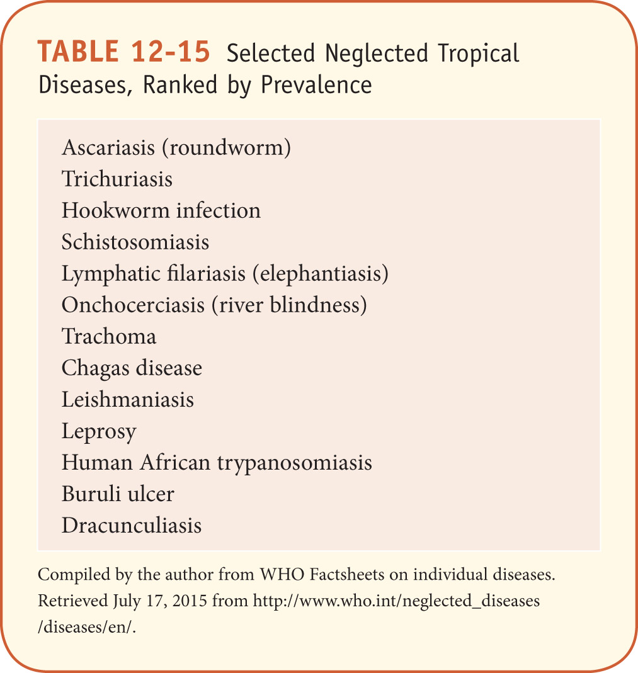
Neglected Tropical Diseases

Slide 74
Onchocerciasis - River Blindness
https://www.paho.org/hq/index.php?option=com_topics&view=article&id=39&Itemid=40762&lang=en
https://www.cartercenter.org/news/features/h/river_blindness/river-blindness-elimination-nigeria.html

Slide 75
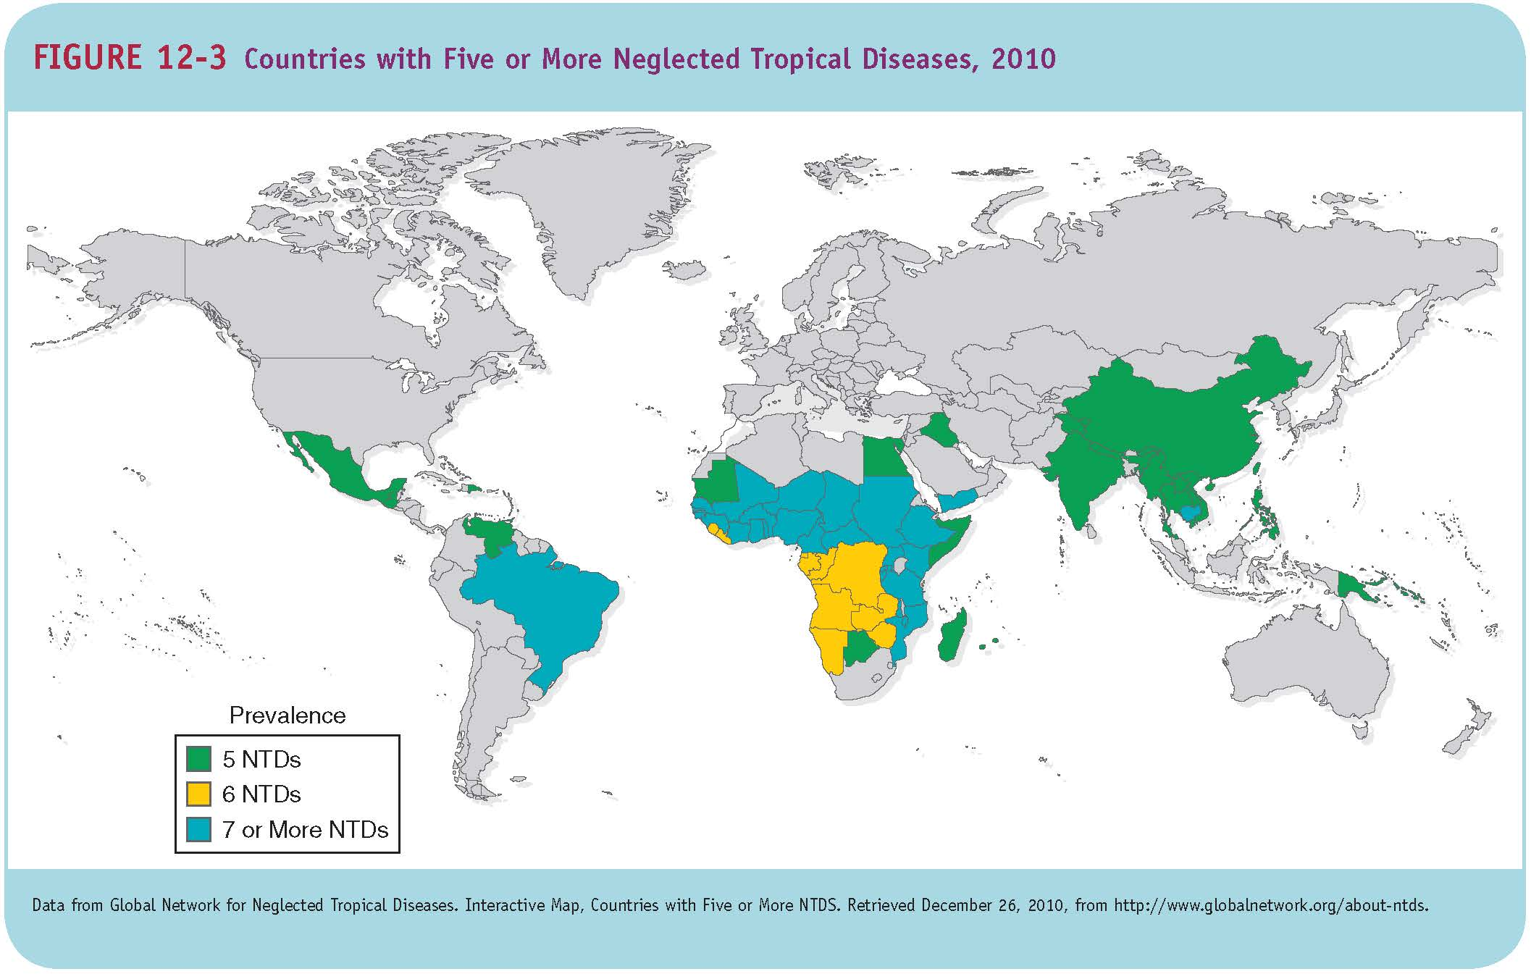
Neglected Tropical Diseases

Slide 76
The Consequences of the Neglected Tropical Diseases
Chronic helminth infection in children can limit the physical and mental development of the child
Pregnant women with anemia, commonly caused by hookworm in low-income countries, are 3.5 times more likely to die during childbirth

Slide 77
Consequences of the Neglected Tropical Diseases
Other possible complications: blindness, liver cancer, remarkable swelling, and skin problems
Increase susceptibility to other infectious diseases
Social stigma
Impact on productivity, school attendance, and future wage-earning capacity

Slide 78
Addressing the Neglected Tropical Diseases
Rapid-impact package of drugs for the seven most common NTDs
Importance of public-private partnerships, such as pharmaceutical companies donating the drugs for rapid-impact package
Periodic deworming of young children is also a “best buy” in global health
Opportunities to integrate NTD treatment programs with existing HIV and malaria control programs

Slide 79
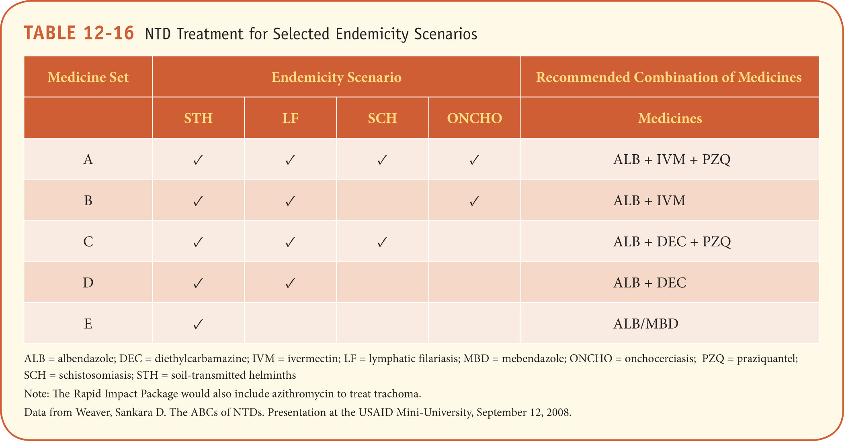
Neglected Tropical Diseases

Slide 80
Future Challenges
Hookworm and schistosomiasis vaccine
Develop new drugs to combat the NTDs more effectively and combat resistance
Work with communities to combat underlying risks such as hygiene, unsafe water supply, unsanitary disposal of human waste, and worm and parasite breeding sites

Slide 81
Future Challenges to the Control of Communicable Diseases
Enhance political commitment to the prevention and control of these diseases
Work with communities to overcome underlying causes
Because health systems in many low- and middle-income countries will continue to be weak, it will be important for efforts to be based on partnerships, building on the success of public-private partnerships

Slide 82
Future Challenges to the Control of Communicable Diseases
Strengthening the surveillance of disease at the local, national, and global levels
The lack of adequately trained and appropriately deployed human resources for health
The challenge of financing enhanced efforts
Scientific and technical challenges
Develop models in low- and middle-income countries to provide chronic care of people with HIV/AIDS

Slide 83
Further Exploration
UNAIDS. (2013). Global report: UNAIDS report on the global AIDS epidemic 2013.
  http://www.unaids.org/en/resources/documents/2013
World Health Organization. (2014). Global tuberculosis report 2014.
  http://www.who.int/tb/publications/global_report/en/

Slide 84
Further Exploration
World Health Organization. (2014). World malaria report 2014.
  http://www.who.int/malaria/publications/world_malaria_report_2014/en/
Global Network Neglected Tropical Diseases. Factsheets and Publications.
  http://www.globalnetwork.org/factsheets-and-publications

